Slide 1

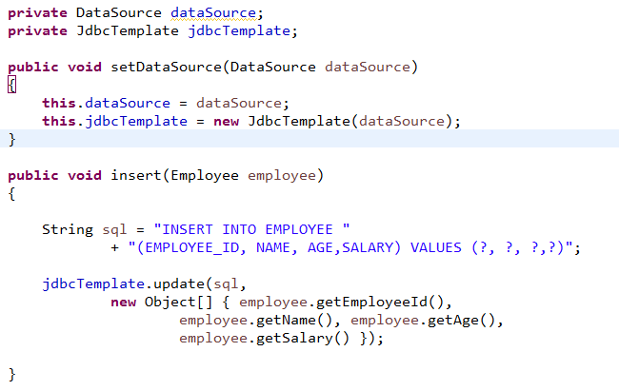
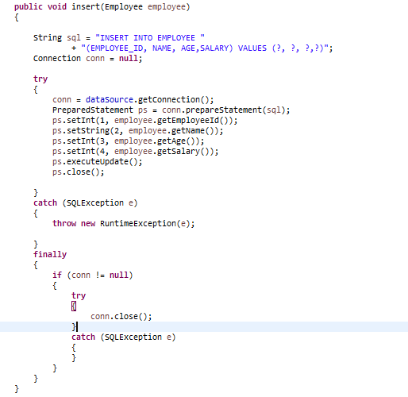
Spring + JdbcTemplate
Without JdbcTemplate, we have to create many redundant codes (create connection , close connection , handle exception) in all the DAO database operation methods – insert, update and delete. It not efficient, ugly, error prone and tedious.
With JdbcTemplate, you save a lot of typing on the redundant codes, because JdbcTemplate will handle it automatically.

Slide 2
Spring + JdbcTemplate

